Slide 1
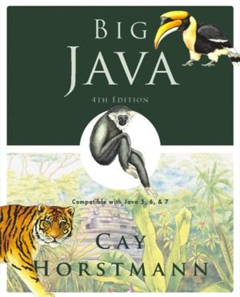
Chapter 1 – Introduction
Big Java by Cay Horstmann
Copyright © 2009 by John Wiley & Sons. All rights reserved.

Slide 2
Chapter Goals
To understand the activity of programming
To learn about the architecture of computers
To learn about machine code and high level programming languages
To become familiar with your computing environment and your compiler
To compile and run your first Java program
To recognize syntax and logic errors
To write pseudocode for simple algorithms
Big Java by Cay Horstmann
Copyright © 2009 by John Wiley & Sons. All rights reserved.

Slide 3
What Is Programming?
Computers are programmed to perform tasks
Different tasks = different programs
Program
Sequence of basic operations executed in succession
Contains instruction sequences for all tasks it can execute
Sophisticated programs require teams of highly skilled programmers and other professionals
Big Java by Cay Horstmann
Copyright © 2009 by John Wiley & Sons. All rights reserved.

Slide 4
Self Check 1.1
What is required to play a music CD on a computer?
Answer: A program that reads the data on the CD and sends output to the speakers and the screen.
Big Java by Cay Horstmann
Copyright © 2009 by John Wiley & Sons. All rights reserved.

Slide 5
Self Check 1.2
Why is a CD player less flexible than a computer?
Answer: A CD player can do one thing – play music CDs. It cannot execute programs.
Big Java by Cay Horstmann
Copyright © 2009 by John Wiley & Sons. All rights reserved.

Slide 6
Self Check 1.3
Can a computer program develop the initiative to execute tasks in a better way than its programmers envisioned?
Answer: No – the program simply executes the instruction sequences that the programmers have prepared in advance.
Big Java by Cay Horstmann
Copyright © 2009 by John Wiley & Sons. All rights reserved.

Slide 7
The Anatomy of a Computer
Central processing unit
Chip
Transistors
Storage
Primary storage: Random-access memory (RAM)
Secondary storage: e.g. hard disk
Removable storage devices: e.g.: floppy disks, tapes, CDs
Peripherals
Executes very simple instructions
Executes instructions very rapidly
General purpose device
Big Java by Cay Horstmann
Copyright © 2009 by John Wiley & Sons. All rights reserved.

Slide 8
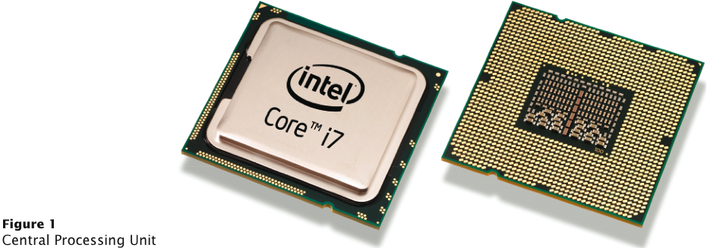
Central Processing Unit
Big Java by Cay Horstmann
Copyright © 2009 by John Wiley & Sons. All rights reserved.

Slide 9
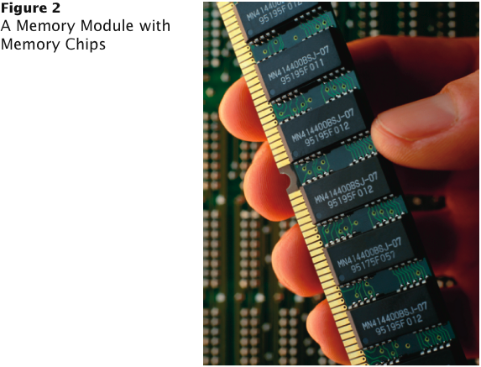
A Memory Module with Memory Chips
Big Java by Cay Horstmann
Copyright © 2009 by John Wiley & Sons. All rights reserved.

Slide 10
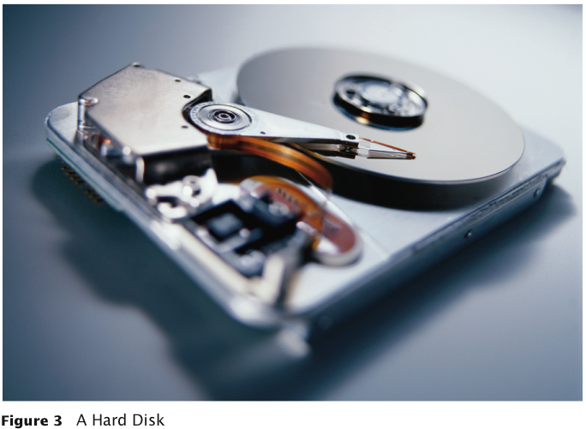
A Hard Disk
Big Java by Cay Horstmann
Copyright © 2009 by John Wiley & Sons. All rights reserved.

Slide 11
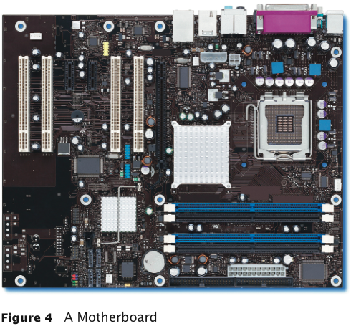
A Motherboard
Big Java by Cay Horstmann
Copyright © 2009 by John Wiley & Sons. All rights reserved.

Slide 12
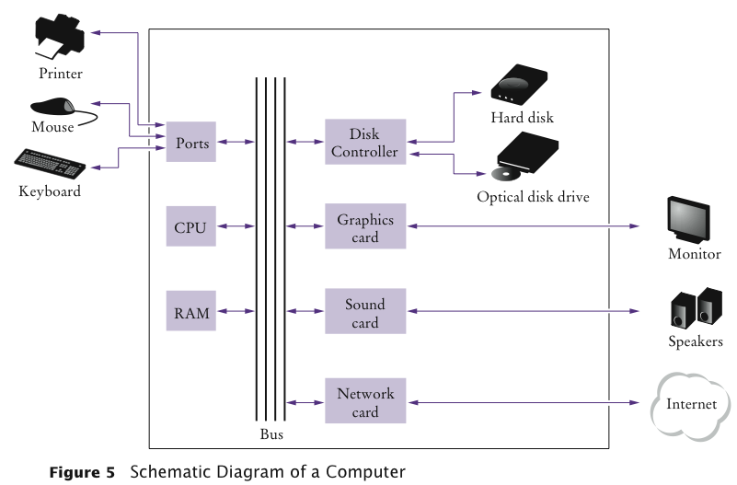
Schematic Diagram of a Computer
Big Java by Cay Horstmann
Copyright © 2009 by John Wiley & Sons. All rights reserved.

Slide 13
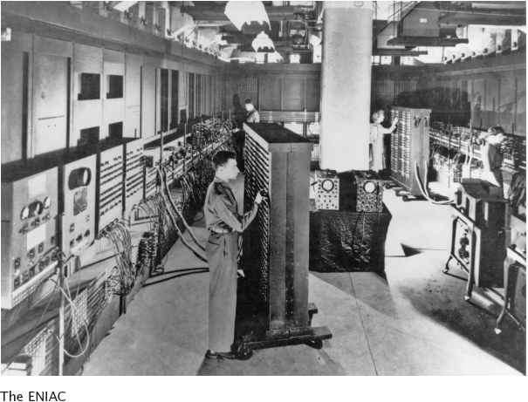
The ENIAC
Big Java by Cay Horstmann
Copyright © 2009 by John Wiley & Sons. All rights reserved.

Slide 14
Self Check 1.4
Where is a program stored when it is not currently running?
Answer: In secondary storage, typically a hard disk.
Big Java by Cay Horstmann
Copyright © 2009 by John Wiley & Sons. All rights reserved.

Slide 15
Self Check 1.5
Which part of the computer carries out arithmetic operations, such as addition and multiplication?
Answer: The central processing unit.
Big Java by Cay Horstmann
Copyright © 2009 by John Wiley & Sons. All rights reserved.

Slide 16
Machine Code
Generally, machine code depends on the CPU type
However, the instruction set of the Java virtual machine (JVM) can be executed on many types of CPU
Java Virtual Machine (JVM) – a typical sequence of machine instructions is:
Load the contents of memory location 40.
Load the value 100.
If the first value is greater than the second value, continue with the instruction that is stored in memory location 240.
Big Java by Cay Horstmann
Copyright © 2009 by John Wiley & Sons. All rights reserved.

Slide 17
Machine Code
Machine instructions are encoded as numbers:
21 40 16 100 163 240
Compiler translates high-level language to machine code
Big Java by Cay Horstmann
Copyright © 2009 by John Wiley & Sons. All rights reserved.

Slide 18
Self Check 1.6
What is the code for the Java virtual machine instruction “Load the contents of memory location 100”?
Answer: 21 100
Big Java by Cay Horstmann
Copyright © 2009 by John Wiley & Sons. All rights reserved.

Slide 19
Self Check 1.7
Does a person who uses a computer for office work ever run a compiler?
Answer: No – a compiler is intended for programmers, to translate high-level programming instructions into machine code.
Big Java by Cay Horstmann
Copyright © 2009 by John Wiley & Sons. All rights reserved.

Slide 20
The Java Programming Language
Simple
Safe
Platform-independent (“write once, run anywhere”)
Rich library (packages)
Designed for the internet
Big Java by Cay Horstmann
Copyright © 2009 by John Wiley & Sons. All rights reserved.

Slide 21
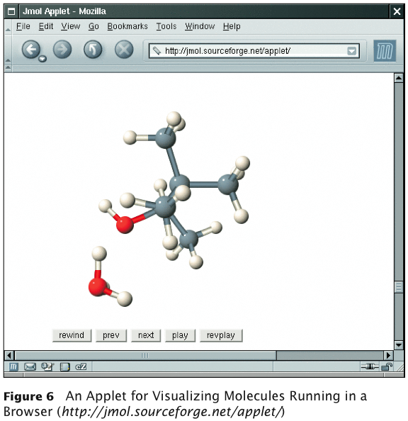
Applet on a Web Page
Big Java by Cay Horstmann
Copyright © 2009 by John Wiley & Sons. All rights reserved.

Slide 22
Java Versions
Version | Year | Important New Features
1.0 | 1996
1.1 | 1997 | Inner classes
1.2 | 1998 | Swing, Collections
1.3 | 2000 | Performance enhancements
1.4 | 2002 | Assertions, XML
5 | 2004 | Generic classes, enhanced for loop, auto-boxing, enumerations
6 | 2006 | Library improvements
7 | 2010 | Small language changes and library improvements
Big Java by Cay Horstmann
Copyright © 2009 by John Wiley & Sons. All rights reserved.

Slide 23
Self Check 1.8
What are the two most important benefits of the Java language?
Answer: Safety and portability.
Big Java by Cay Horstmann
Copyright © 2009 by John Wiley & Sons. All rights reserved.

Slide 24
Self Check 1.9
How long does it take to learn the entire Java library?
Answer: No one person can learn the entire library – it is too large.
Big Java by Cay Horstmann
Copyright © 2009 by John Wiley & Sons. All rights reserved.

Slide 25
ch01/hello/HelloPrinter.java
1 public class HelloPrinter
2 {
3 public static void main(String[] args)
4 {
5 // Display a greeting in the console window
6
7 System.out.println("Hello, World!");
8 }
9 }
Program Run:
Hello, World!
Big Java by Cay Horstmann
Copyright © 2009 by John Wiley & Sons. All rights reserved.

Slide 26
The Structure of a Simple Program: Class Declaration
Classes are the fundamental building blocks of Java programs:
public class HelloPrinter
starts a new class
Every source file can contain at most one public class
The name of the public class must match the name of the file containing the class:
Class HelloPrinter must be contained in a file named HelloPrinter.java
Big Java by Cay Horstmann
Copyright © 2009 by John Wiley & Sons. All rights reserved.

Slide 27
The Structure of a Simple Program: main Method
Every Java application contains a class with a main method
When the application starts, the instructions in the main method are executed
public static void main(String[] args)
{
. . .
}
declares a main method
Big Java by Cay Horstmann
Copyright © 2009 by John Wiley & Sons. All rights reserved.

Slide 28
The Structure of a Simple Program: Comments
The first line inside the main method is a comment:
// Display a greeting in the console window
Compiler ignores any text enclosed between // and end of the line
Use comments to help human readers understand your program
Big Java by Cay Horstmann
Copyright © 2009 by John Wiley & Sons. All rights reserved.

Slide 29
The Structure of a Simple Program: Statements
The body of the main method contains statements inside the curly brackets ({})
Each statement ends in a semicolon (;)
Statements are executed one by one
Our method has a single statement:
System.out.println("Hello, World!");
which prints a line of text:
Hello, World
Big Java by Cay Horstmann
Copyright © 2009 by John Wiley & Sons. All rights reserved.

Slide 30
The Structure of a Simple Program: Method Call
System.out.println("Hello, World!");
is a method call
A method call requires:
The object that you want to use (in this case, System.out)
The name of the method you want to use (in this case, println)
Parameters enclosed in parentheses (()) containing any other information the method needs (in this case, "Hello, World!")
Big Java by Cay Horstmann
Copyright © 2009 by John Wiley & Sons. All rights reserved.

Slide 31
Syntax 1.1 Method Call
Big Java by Cay Horstmann
Copyright © 2009 by John Wiley & Sons. All rights reserved.

Slide 32
The Structure of a Simple Program: Strings
String: a sequence of characters enclosed in double quotation marks:
"Hello, World!"
Big Java by Cay Horstmann
Copyright © 2009 by John Wiley & Sons. All rights reserved.

Slide 33
Self Check 1.10
How would you modify the HelloPrinter program to print the words "Hello," and "World!" on two lines?
Answer:
System.out.println("Hello,"); System.out.println("World!");
Big Java by Cay Horstmann
Copyright © 2009 by John Wiley & Sons. All rights reserved.

Slide 34
Self Check 1.11
Would the program continue to work if you omitted the line starting with //?
Answer: Yes – the line starting with // is a comment, intended for human readers. The compiler ignores comments.
Big Java by Cay Horstmann
Copyright © 2009 by John Wiley & Sons. All rights reserved.

Slide 35
Self Check 1.12
What does the following set of statements print?
System.out.print("My lucky number is"); System.out.println(3 + 4 + 5);
Answer: The printout is
My lucky number is12
It would be a good idea to add a space after the is.
Big Java by Cay Horstmann
Copyright © 2009 by John Wiley & Sons. All rights reserved.

Slide 36
Editing a Java Program
Use an editor to enter and modify the program text
Java is case-sensitive
Be careful to distinguish between upper- and lowercase letters
Lay out your programs so that they are easy to read
Big Java by Cay Horstmann
Copyright © 2009 by John Wiley & Sons. All rights reserved.

Slide 37
Compiling and Running a Java Program
The Java compiler translates source code into class files that contain instructions for the Java virtual machine
A class file has extension .class
The compiler does not produce a class file if it has found errors in your program
The Java virtual machine loads instructions from the program's class file, starts the program, and loads the necessary library files as they are required
Big Java by Cay Horstmann
Copyright © 2009 by John Wiley & Sons. All rights reserved.

Slide 38
Animation 1.1: Compiling and Running a Program
Big Java by Cay Horstmann
Copyright © 2009 by John Wiley & Sons. All rights reserved.

Slide 39
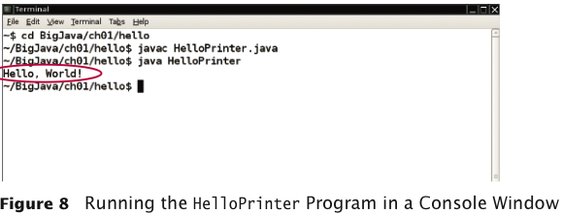
HelloPrinter in a Console Window
Big Java by Cay Horstmann
Copyright © 2009 by John Wiley & Sons. All rights reserved.

Slide 40
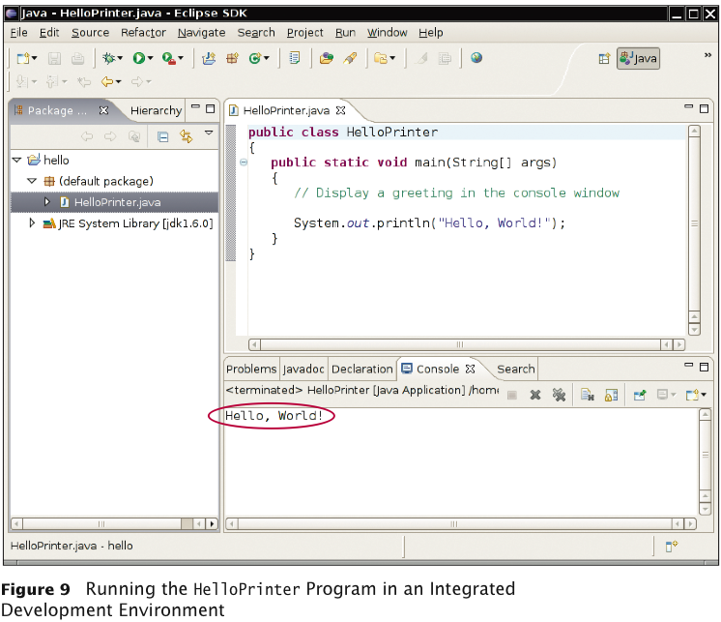
HelloPrinter in an IDE
Big Java by Cay Horstmann
Copyright © 2009 by John Wiley & Sons. All rights reserved.

Slide 41
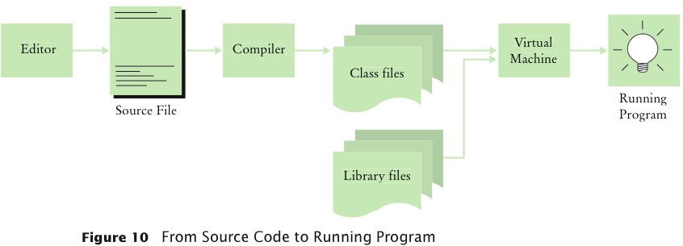
From Source Code to Running Program
Big Java by Cay Horstmann
Copyright © 2009 by John Wiley & Sons. All rights reserved.

Slide 42
Self Check 1.13
Can you use a word processor for writing Java programs?
Answer: Yes, but you must remember to save your file as “plain text”.
Big Java by Cay Horstmann
Copyright © 2009 by John Wiley & Sons. All rights reserved.

Slide 43
Self Check 1.14
What do you expect to see when you load a class file into your text editor?
Answer: A sequence of random characters, some funny looking. Class files contain virtual machine instructions that are encoded as binary numbers.
Big Java by Cay Horstmann
Copyright © 2009 by John Wiley & Sons. All rights reserved.

Slide 44
Errors
Compile-time error: A violation of the programming language rules that is detected by the compiler
Example:
System.ou.println("Hello, World!);
Syntax error
Run-time error: Causes the program to take an action that the programmer did not intend
Examples:
System.out.println("Hello, Word!"); System.out.println(1/0);
Logic error
Big Java by Cay Horstmann
Copyright © 2009 by John Wiley & Sons. All rights reserved.

Slide 45
Error Management Strategy
Learn about common errors and how to avoid them
Use defensive programming strategies to minimize the likelihood and impact of errors
Apply testing and debugging strategies to flush out those errors that remain
Big Java by Cay Horstmann
Copyright © 2009 by John Wiley & Sons. All rights reserved.

Slide 46
Self Check 1.15
Suppose you omit the // characters from the HelloPrinter.java program but not the remainder of the comment. Will you get a compile-time error or a run-time error?
Answer: A compile-time error. The compiler will not know what to do with the word Display.
Big Java by Cay Horstmann
Copyright © 2009 by John Wiley & Sons. All rights reserved.

Slide 47
Self Check 1.16
When you used your computer, you may have experienced a program that “crashed” (quit spontaneously) or “hung” (failed to respond to your input). Is that behavior a compile-time error or a run-time error?
Answer: It is a run-time error. After all, the program had been compiled in order for you to run it.
Big Java by Cay Horstmann
Copyright © 2009 by John Wiley & Sons. All rights reserved.

Slide 48
Self Check 1.17
Why can't you test a program for run-time errors when it has compiler errors?
Answer: When a program has compiler errors, no class file is produced, and there is nothing to run.
Big Java by Cay Horstmann
Copyright © 2009 by John Wiley & Sons. All rights reserved.

Slide 49
Algorithms
Algorithm: A sequence of steps that is:
unambiguous
executable
terminating
Algorithm for deciding which car to buy, based on total costs:
For each car, compute the total cost as follows:
annual fuel consumed = annual miles driven / fuel efficiency
annual fuel cost = price per gallon x annual fuel consumed
operating cost = 10 x annual fuel cost
total cost = purchase price + operating cost
If total cost1 < total cost2
Choose car1
Else
Choose car2
Big Java by Cay Horstmann
Copyright © 2009 by John Wiley & Sons. All rights reserved.

Slide 50
Pseudocode
Pseudocode: An informal description of an algorithm:
Describe how a value is set or changed:
total cost = purchase price + operating cost
Describe decisions and repetitions:
For each car
operating cost = 10 x annual fuel cost
total cost = purchase price + operating cost
Use indentation to indicate which statements should be selected or repeated
Indicate results:
Choose car1
Big Java by Cay Horstmann
Copyright © 2009 by John Wiley & Sons. All rights reserved.

Slide 51
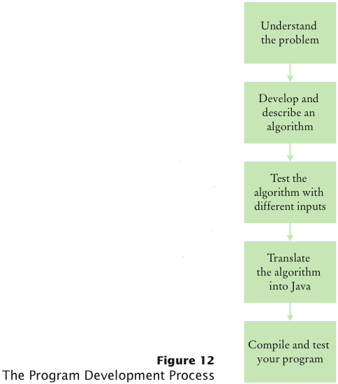
Program Development Process
Big Java by Cay Horstmann
Copyright © 2009 by John Wiley & Sons. All rights reserved.

Slide 52
Self Check 1.18
Investment Problem: You put $10,000 into a bank account that earns 5 percent interest per year. How many years does it take for the account balance to be double the original?
Algorithm:
Start with a year value of 0 and a balance of $10,000.
Repeat the following steps while the balance is less than $20,000.
Add 1 to the year value.
Multiply the balance value by 1.05 (a 5 percent increase).
Suppose the interest rate was 20 percent. How long would it take for the investment to double?
Answer: 4 years:
0 10,000
1 12,000
2 14,400
3 17,280
4 20,736
Big Java by Cay Horstmann
Copyright © 2009 by John Wiley & Sons. All rights reserved.

Slide 53
Self Check 1.19
Suppose your cell phone carrier charges you $29.95 for up to 300 minutes of calls, and $0.45 for each additional minute, plus 12.5 percent taxes and fees. Give an algorithm to compute the monthly charge for a given number of minutes.
Answer:
Is the number of minutes at most 300?
If so, the answer is $29.95 × 1.125 = $33.70.
If not,
Compute the difference: (number of minutes) – 300.
Multiply that difference by 0.45.
Add $29.95.
Multiply the total by 1.125. That is the answer.
Big Java by Cay Horstmann
Copyright © 2009 by John Wiley & Sons. All rights reserved.

